Slide 1


AI YOGI
PROJECT
Presented by:
Aritra, Aparna, Shikhara, Bhavya and Siddharth

Slide 2

PROBLEMS
THERMAL IMAGE LANDMARK AND AREA PREDICTION
01
EYE MOVEMENT TRACKING
02
YOGA POSE DETECTION
03

Slide 3




SOLUTION PROCESS
DEVELOPED A MODEL USING PYTHON TO FIRST DETECT THE THERMAL IMAGE AND THEN ANNOTATE IT BY PUTTING LANDMARKS AND ALSO PREDICT AREAS WHEREVER REQUIRED
DEVELOPED A MODEL USING PYTHON AND OPENCV TO FIRST DETECT THE SPECIFIC FRAME SIZE IN THE INPUT AND MARKS THE IRIS, AND THEN DETECT AND REPRESENT THE MOTION USING A GRAY-SCALE IMAGE
DEVELOPED A MODEL USING PYTHON AND OPENCV TO DETECT THE POSTURE OF THE BODY AS INPUT AND MARK BODY PARTS AS POINTS AND DETECT THE ANGLES AND POSITION OF BODY PARTS
01
02
03

Slide 4
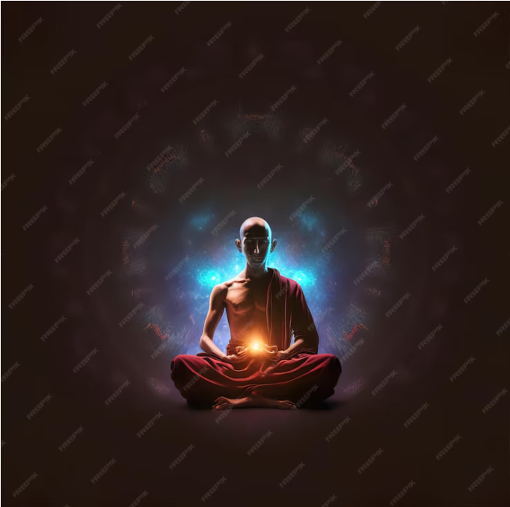


FRAMEWORKS AND LIBRARIES
Front End
  Dash, Tailwind CSS
Back End
  Flask, Next.js, Express.js
OpenCV
Python
Dlib's face detection Models
TO DEVELOP THE SOFTWARE
TO BUILD THE ML MODELS

Slide 5

CONTRIBUTION OF THE TEAM
01
ARITRA RAY
  Contributed on the FRONT END of the Relaxation system
  Successfully integrated all the ML models (Pose detection, Eye motion tracking, Thermal image)
04
BHAVYA CHARITHA
  Worked on eye motion tracking to detect any changes in the position of iris in OpenCV
  The model is integrated with the software to show the grayscale output for a given input for a particualr frame size
02
APARNA PANDEY
  Worked on the THERMAL IMAGING MODEL for thermography and to detect areas temperature like area above the eyes, below lips, on the cheeks etc.
05
SIDDHARTH S
  Worked on the backend of the relaxation system using MySQL - database creation, connection, etc.
03
BHANDARI SHIKHARA
  Worked on the posture detection and recognition of the input data using OpenCV to detect any vodily motion in the input data.

Slide 6






IMPROVEMENT IN OUR SKILLS THROUGH THE PROJECT
Learned Cutting Edge Technologies
We learned and implemented programming languages, frameworks and libraries which are industry standared. It will help us to build other real time projects in future.
Continuous Improvement and Error Handling
Learning from mistakes is one of the important things we learned during our this project. Initially we tried different types modules and frameworks. But after facing errors in integration we decided to use other frameworks which helped us to handle those errors.
Group work
One of the key factor to succeed in a project is to work as a team. We learned this unmentioned skill to excel

Slide 7


LIMITATIONS OF OUR MODEL
  Real-time implementation of complex features like thermal imaging and eye detection is a challenge for our model, making offline analysis using videos from local devices or backend dataframes more practical.
  Images must be resized to the dimensions the model was trained on, such as 464x348, for compatibility with the thermal imaging model.
  Input must allow a specific dimension 1280x720 in pixel for eye motion tracking and grayscale display of the iris motion.
  Use of MySQL for video stream storage is not practical due to the storage as large binary object files, which makes retrieval and storage inefficient

Slide 8




FUTURE SCOPE
THERMAL IMAGE
EYE MOTION TRACKING
POSTURE DETECTION
To make the model flexible such that it can also predict for the videos recorded using thermal imaging cameras.
The model can be extended to record the count of number of times movement is detected and identify coordinate changes
Detection of angles at joints in the posture can be worked upon in addition to the already present other angles

Slide 9

TIMELINE
January
In this month we familiarized ourselves with the frameworks and libraries that were need and learned from various courses online.
We did the debugging of the existing models and worked on improvement in the model according to the need of this project.
February
We worked on the integration of the model in the software along with the all the final touch that were needed to run the model smoothly.
March
We worked on the presentation part through slides and video to represent our model.
April

Slide 10
VIDEO LINK
.

Slide 11

Thanks For Your Valuable Time !!

Slide 12








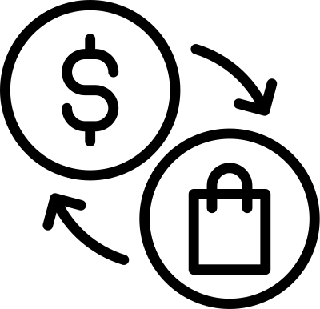







































RESOURCE PAGE

